Slide 1

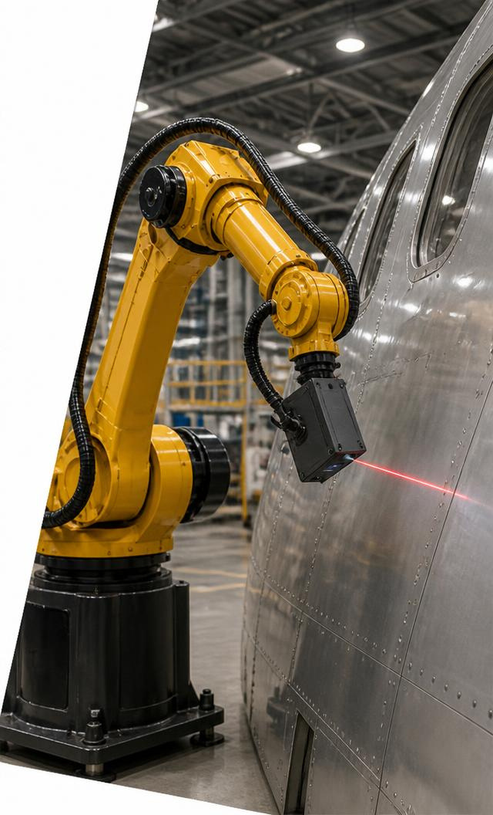
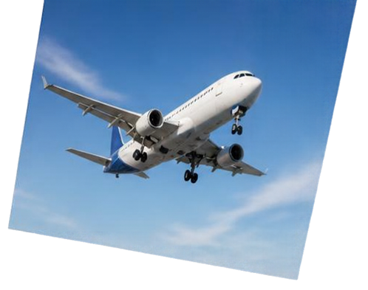
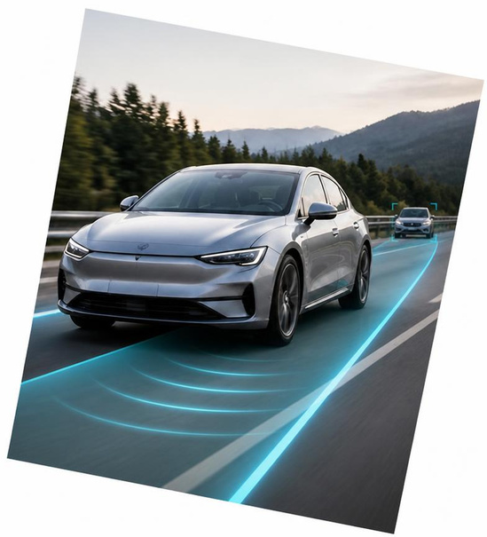
Autonomy in Motion
Rasitha R
Motion Planning & Execution

Slide 2
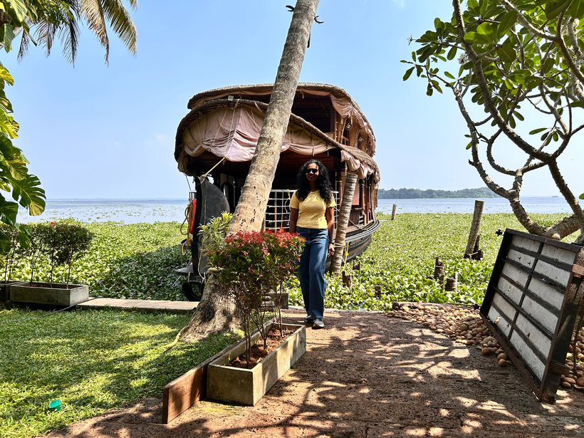
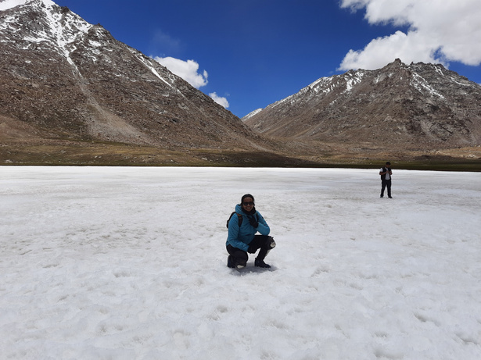
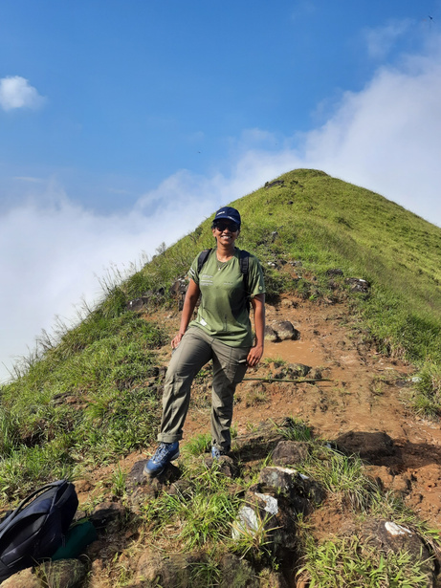
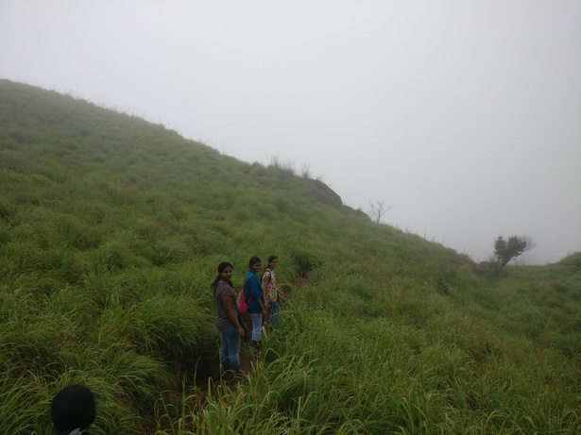



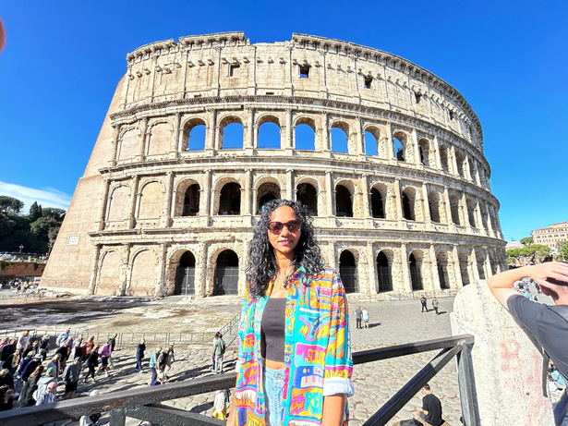
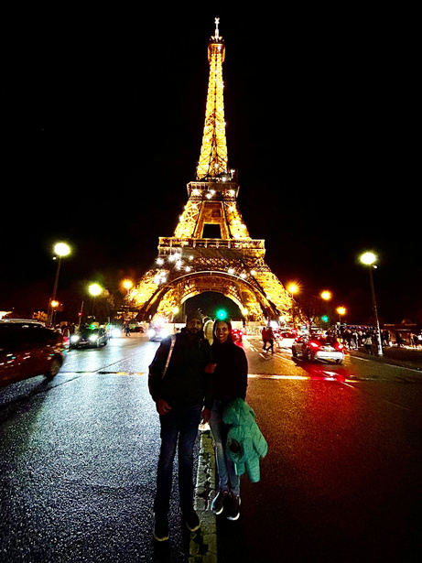
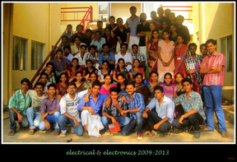

What Shaped My Journey
Rooted in Kerala. Shaped by curiosity.
Roots & expression
Curiosity & exploration
Imagination & perspective
Kerala’s culture → classical dance
Kerala’s Western Ghats & beaches
sparked trekking & travel
Reading, encouraged by my husband
Classical dance
Expression through
precision and practice
Discipline • precision • creativity
Resilience • adaptability • openness
Imagination • reflection • questioning
2011 • Bachelor’s
Engineering foundation
2011–2013
Guest Lecturer
Teaching & mentoring
2013–2015 • Master’s
Control Systems
Calicut University
GUIDING PRINCIPLES Grounded Roots • Precision Creativity • Expedition Resilience • Cognitive Integrity

Slide 3
What Shaped My Journey
Rooted in Kerala. Shaped by curiosity.
Kerala roots
Exploration
Reading & imagination
Kerala’s culture sparked
my love of classical dance.
Kerala’s Western Ghats & beaches
sparked trekking & travel.
My husband inspired my reading.
It fuels imagination & creativity.
Education & teaching
2011 • Bachelor’s
Engineering foundation
2011–2013
Guest Lecturer
Teaching & mentoring
2013–2015 • Master’s
Control Systems
Calicut University
GUIDING PRINCIPLES Grounded Roots • Precision Creativity • Expedition Resilience • Cognitive Integrity

Slide 4
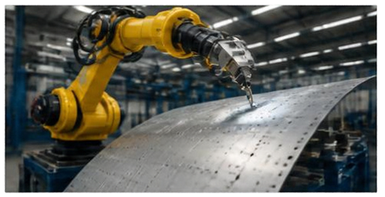
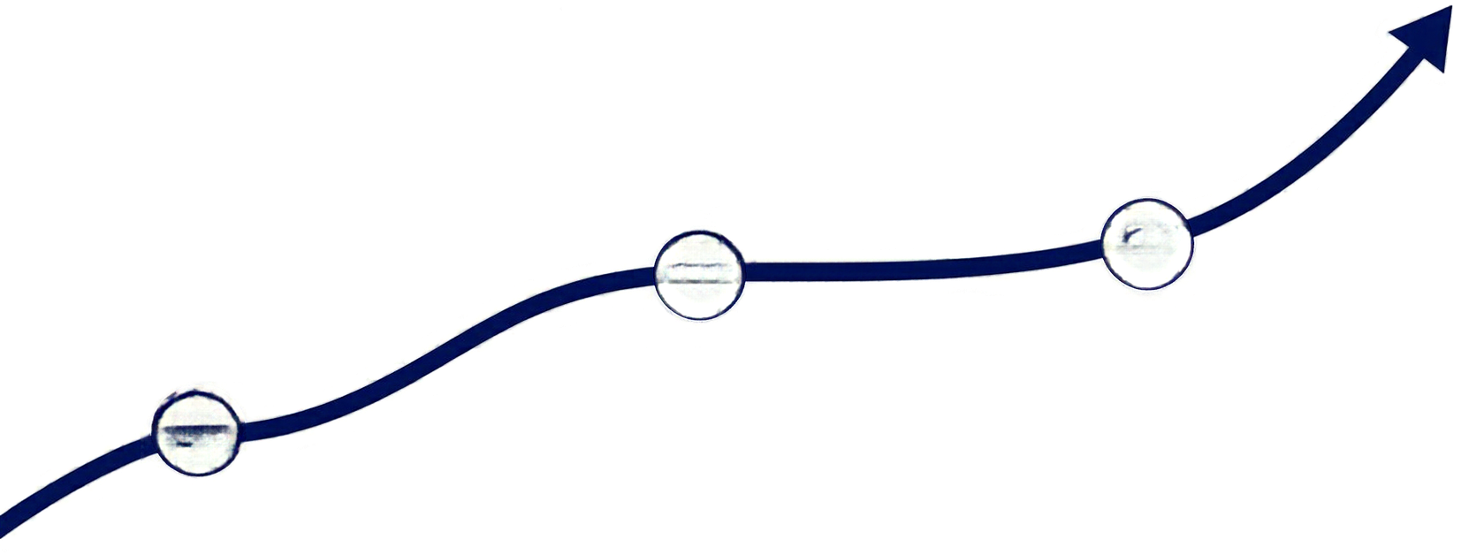
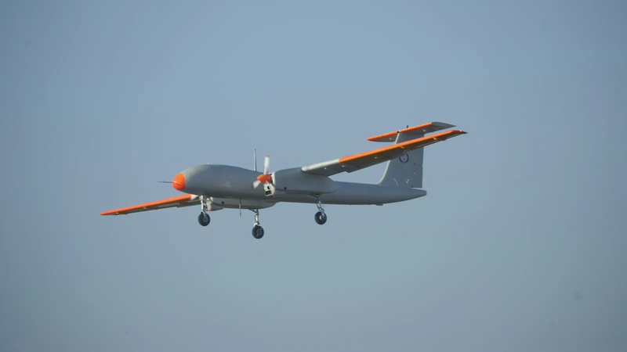
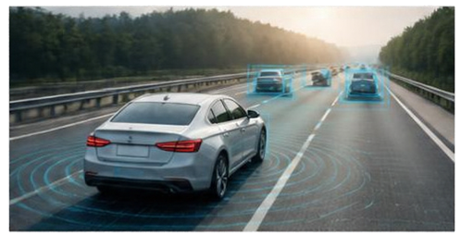


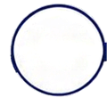
Career trajectory
One passion for autonomy, across flight, vehicles and factories
2015–2016 ADE–DRDO
Aeronautical Development
Establishment
03
02
  Enabled Rustom-2’s maiden flight with flight-control stabilisation software
2016–2022 Danlaw
2022–Present Airbus
  Led autonomous systems development
  Enabled autonomous platooning through leader–follower coordination.
  Leading motion planning
  Enabling less manual programming & reuse across applications
01
Programmes: A320 inspection • eAction
Rustom-2 photo: Government of India / DRDO, CC BY-SA 4.0

Slide 5


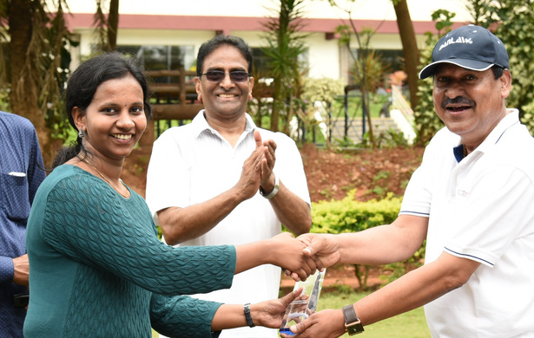
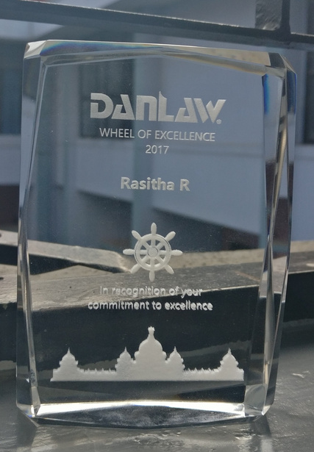



Achievements & recognition
Academic excellence, industry recognition and continued learning
2× Wheel of Excellence
Spot Award
Danlaw
For contributions in 2017 & 2018
Airbus
Wings of Wonder presentation
2022
Deep Learning
Specialization
Neural Networks
and Deep Learning
Coursera
Coursera
Notes:
Gold Medallist for a master’s in Control Systems at Calicut University. Wheel of Excellence Award at Danlaw, received twice. Spot Award from Airbus. Certifications: Design and Analysis of Algorithms from NPTEL; Deep Learning Specialization and Neural Networks and Deep Learning from Coursera; Simulink Model Management and Architecture from MathWorks. Award illustrations are generic symbolic artwork generated with imagegen; they are not photographs of the actual awards.

Slide 6
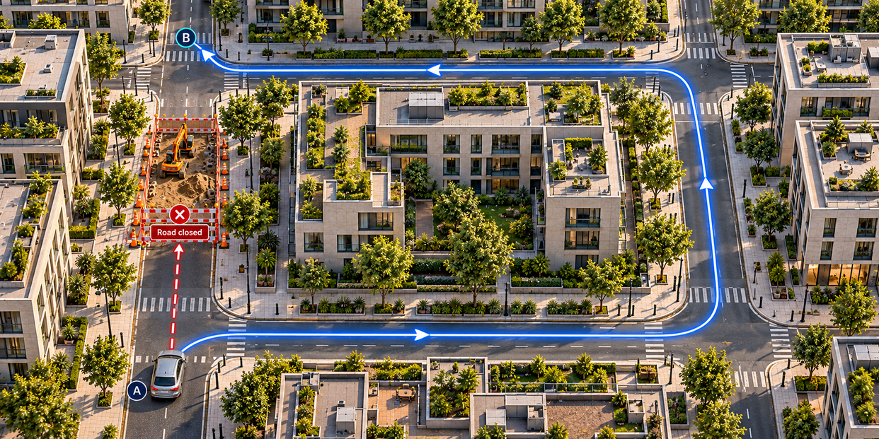
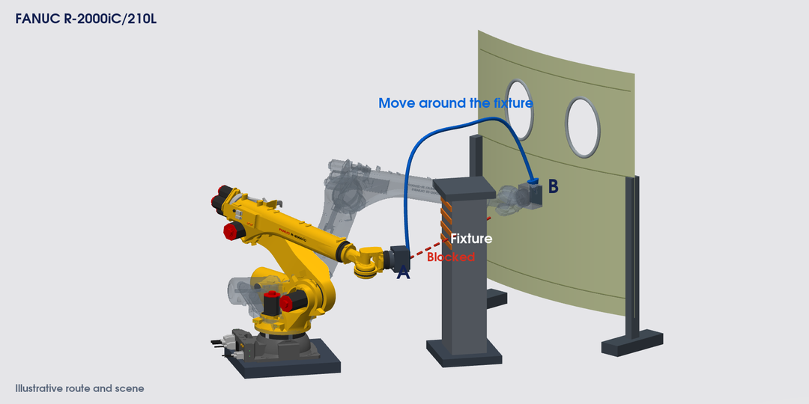
Motion planning
From Google Maps to robot movement
On the road
A: Start point • B: Destination
Obstacle: Roadworks block the direct road.
Plan: Take a detour around the block.
At the aircraft
A: Start position • B: Inspection position
Obstacle: A fixture blocks the direct route.
Plan: Move around it with the whole arm.
Maps guides the driver. Robot planning works out how the whole arm moves.

Slide 7
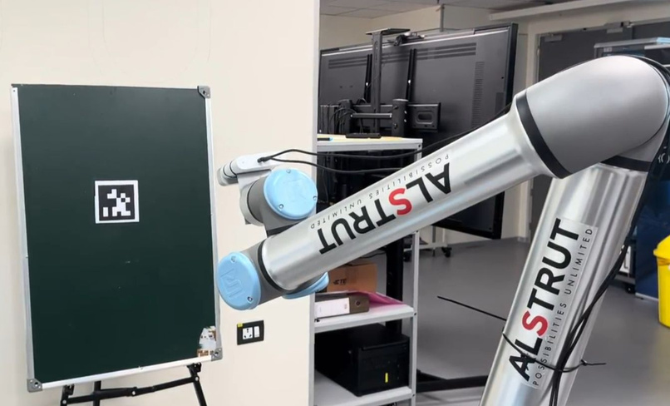
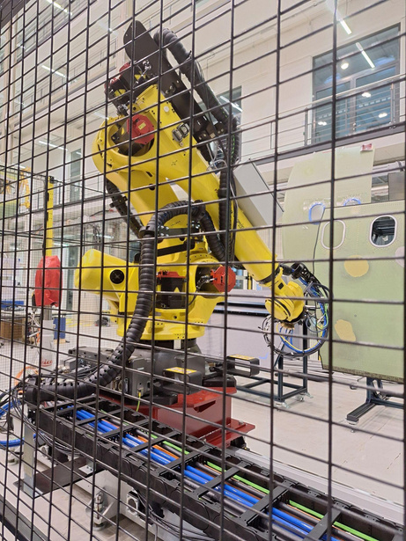
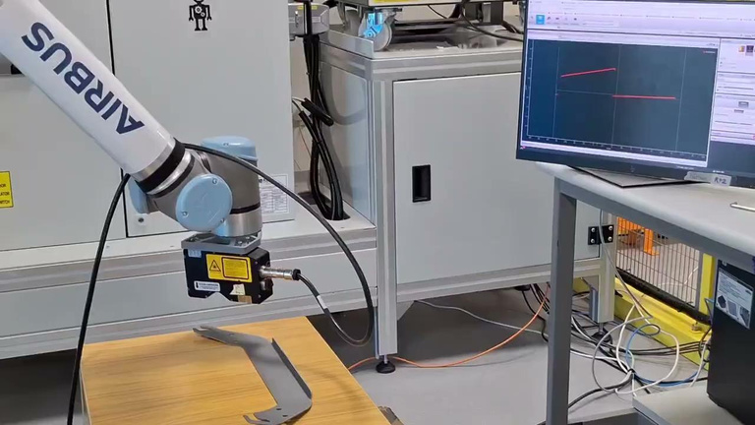
My Airbus milestones
Integrated motion planning • validated inspection • adaptive execution
REACT
Primer Skin NDT Inspection
SAMU · Sealant deposition
  Led first complete robotics software stack
  Vision, motion planning & control
  Delivered TRL3 & pre-TRL4
  TRL4: autonomous motion planning
  Repeatable scan coverage
  Less operator effort & variability
  Enabled adaptive dispensing
  Sensor-guided dynamic path correction
NDT – Non Destructive Testing • SAMU – Spraying and Auto Masking Unit

Slide 8
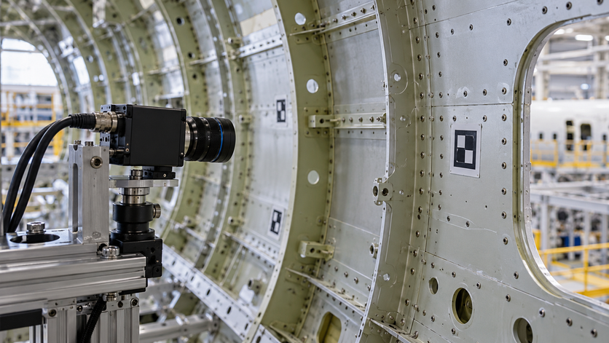
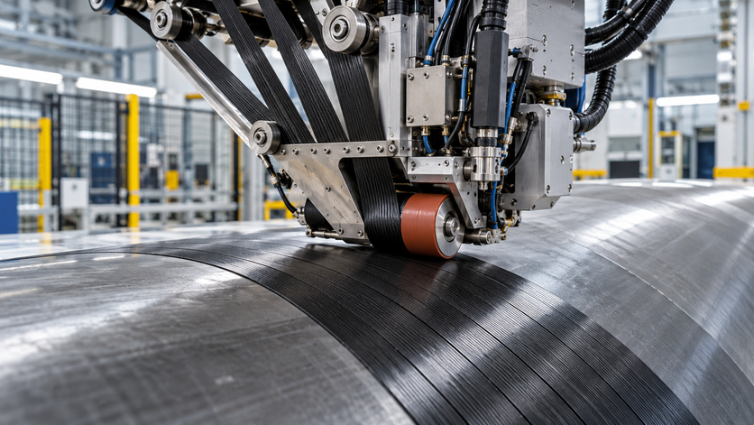
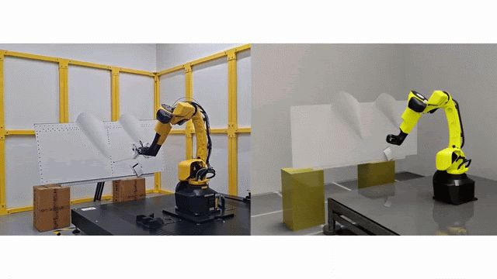
My Airbus milestones
Reusable software • process quality • adaptable planning
IMOD2 · MATS
eAction · Nextgen Layup
Intelligent Scan & Plan
  Unifying software with RXU Control
  Building reusable robot control
  Leading data-driven layup optimisation
  Detecting deviations that threaten quality
  Targeting fewer missing tows and less rework
  Lead/mentor: scan and planning
  Defect sequencing
  Adapts to panel shape & position
MATS and eAction visuals: conceptual illustrations. • Scan & Plan: Saint-Nazaire.

Slide 9

Innovation at Airbus
Two proofs of concept. More adaptable robotics.
Adaptive motion with RL
Manipulation with Physical AI
POC lead • built on 1XRD learnings
Mentor • 1XRD collaboration
  RL-powered dynamic navigation
  Adapts to changing obstacles
  Transfers learned motion to new panels without reprogramming
  Jointly guided task-specific VLA model selection with 1XRD
  Automated decision-making for delicate object manipulation, with touch guiding robot motion
Apply Physical AI to automate decisions where it addresses Manufacturing Engineering needs and delivers tangible process value.

Slide 10
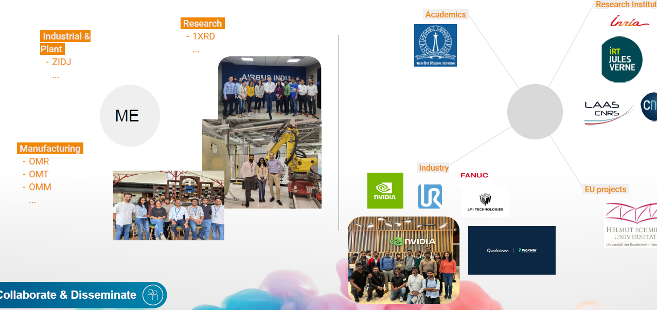

My network & technical influence
Collaboration across Airbus, academia, research and industry
WITHIN AIRBUS
BEYOND AIRBUS
Industrial &
plant
Motion planning & execution
Academia
ZIDJ
Research institutes
Research
1XRD
CNRS
Rasitha
Industry
Manufacturing
OMR, OMT, OMM
EU collaborations
Helmut Schmidt University
COLLABORATE & DISSEMINATE
I connect teams and share results that others can reuse.
Joint development and knowledge sharing
Notes:
Style option for slide 9 of Autonomy in Motion. Rebuilt from the user reference image(20261020-060042).png using native editable text and diagram objects, with its real photos and logos retained using native crop windows. The screenshot is low resolution. Use original photo/logo files for final quality. Airbus siglums are transcribed as ZIDJ, 1XRD, OMR, OMT and OMM. Verify whether the research siglum begins with the numeral 1. CNRS and Helmut Schmidt logos are cut off at the reference edge and therefore appear as plain text. The user reference places Helmut Schmidt University under EU projects; confirm actual project names before finalisation. Categories represent the user-provided network, not invented endorsements. Suggested contribution statement: I connect teams and share results that others can reuse. Circular design requested by the user. Seven lines represent collaboration and knowledge exchange, not measured influence or a reporting hierarchy. Central name uses the user's supplied profile name. Slides 1 to 8 of the approved main deck are unchanged.

Slide 11
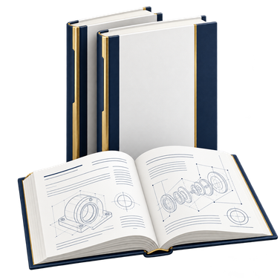

Turning technical ideas into shared knowledge
2 white papers • 1 IDD • 1 active patent
Shared knowledge
Technical innovation
WHITE PAPER 1
IDD / DEFENSIVE PUBLICATION
A review of path and motion planning in robotics: core components, evolution, and learning based methods
A novel framework for real-time, hard constrained reinforcement learning in robotics
  Guide planner selection
  Inform technology decisions
  Reuse constrained-learning methods
  Support controlled AI adoption
WHITE PAPER 2
PATENT / ACTIVE
Intelligent programming for industrial robots in aircraft manufacturing: a case study on bridging offline and online paradigms
Self aware motion planning algorithms
Real-time collision / singularity avoidance for autonomous trajectory generation on diverse panel surfaces
  Guide teams from offline programming to online adaptation
  Enable flexible manufacturing
  Reduce manual motion correction
  Adapt across panel shapes
Notes:
WHITE PAPER 1
A review of path and motion planning in robotics: core components, evolution, and learning-based methods
Authors: Rasitha R, Phani Kiran
Proposed team value: Common reference for planner selection and skill development
Proposed Airbus value: Supports consistent robotics technology choices
WHITE PAPER 2
Intelligent programming for industrial robots in aircraft manufacturing: a case study on bridging offline and online paradigms
Authors: Rasitha R, Phani Kiran
Proposed team value: Guidance on offline preparation and online adaptation
Proposed Airbus value: Supports more flexible aircraft manufacturing automation
IDD / DEFENSIVE PUBLICATION
A novel framework for real-time, hard-constrained reinforcement learning in robotics
Proposed team value: Framework for evaluating learning with hard constraints
Proposed Airbus value: Supports assessment of learning-based automation within operating limits
PATENT / ACTIVE
Self-aware motion planning algorithms. Real-time collision / singularity avoidance for autonomous trajectory generation on diverse panel surfaces
Authors: Parameswaran S, Rasitha R, Alexandre Arnold
Proposed team value: Automated collision and singularity avoidance approach
Proposed Airbus value: Targets less manual reprogramming across panel shapes
Titles, authors and statuses supplied by Rasitha R. Display titles are shortened for readability. Value statements are inferred from the supplied titles and scope, rather than verified adoption, measured results or legal conclusions. Active patent status is reproduced as supplied and does not assert a grant or filing stage. Defensive-publication authors were not supplied. All images are symbolic AI-generated illustrations.

Slide 12
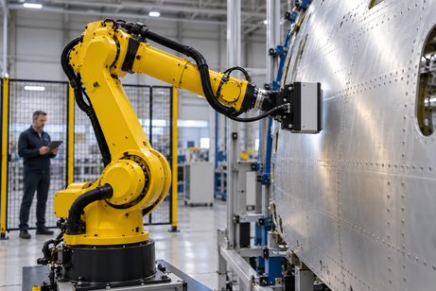
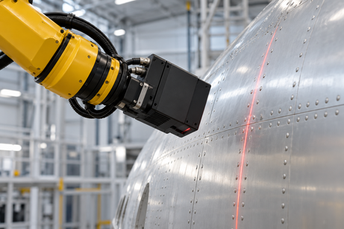
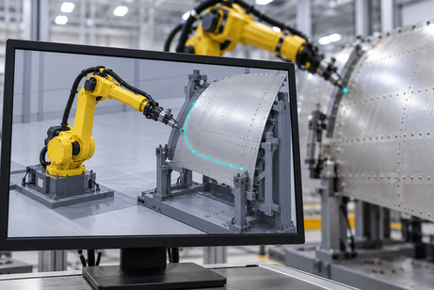
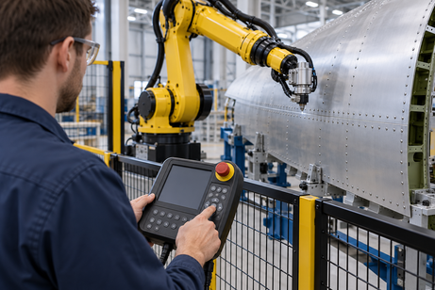
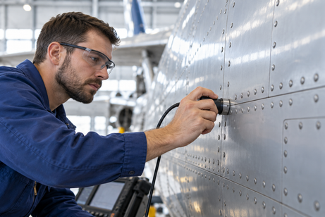
A progressive path to autonomy
From a person guiding each move to a robot handling a defined task
5
Task
autonomy
Adaptive
execution
Robot handles an agreed task
4
Less routine intervention
Robot adjusts to the surface
3
Automatic
planning
Less manual correction
Programmed
automation
2
Software prepares the route
Less programming effort
Robot repeats a taught routine
Manual
control
1
Repeatable known processes
People guide the inspection
Expert process knowledge
Increase autonomy where it adds value. Validate every step.
Notes:
Source: user-supplied reference image(20261020-101400).png for the 3D pyramid shape, and the previously supplied progressive-autonomy slide for content. The five layers distinguish manual control, programmed automation, automatic planning, adaptive execution and task autonomy. NC and offline programming are grouped into programmed automation. These are conceptual capabilities, not a formal autonomy standard. Human expertise, models and offline preparation remain useful. Task autonomy applies to selected tasks within agreed and validated limits. Benefits are intended value, not measured results. Pyramid dimensions are illustrative and do not quantify adoption, scale or intelligence. Suggested narration: Each layer adds a capability. We begin with human expertise and repeatable programs. Planning software reduces preparation effort. Feedback helps the robot adjust. The top is autonomy for selected tasks within validated limits.
Images are AI-generated conceptual illustrations, not photographs of Airbus projects or proof of achieved autonomy. Each scene illustrates the same aircraft-inspection setting. Manual: a person positions a probe. Programmed: a taught repeatable robot routine. Automatic planning: software prepares a route. Adaptive: a wrist-mounted scanner measures the surface to support adjustment. Task autonomy: the robot carries out an agreed inspection task under human supervision. Offline programming and NC remain examples of programmed automation. Intended value is illustrative, not a measured performance claim.
Image prompt set: [{"key":"manual","prompt":"Use case: photorealistic-natural. Asset type: one small landscape photograph-style conceptual illustration for a presentation about progressive manufacturing autonomy, not documentary evidence. Wide 3:2 composition, polished realistic industrial photography, cool neutral hangar, bright soft lighting, physically plausible hardware, uncluttered close framing for legibility at thumbnail size. Curved aluminium aircraft skin panel with rows of rivets. No logos, text, labels, decorative graphics, watermarks or sci-fi holograms. Show a human inspection technician, wearing blue work clothes and safety glasses, manually holding an ultrasonic inspection probe directly against the aircraft skin with their right hand and checking the surface. Hand, probe and surface are central and clear. A realistic human guides the entire operation. No robot."},{"key":"programmed","prompt":"Use case: photorealistic-natural. Asset type: one small landscape photograph-style conceptual illustration for a presentation about progressive manufacturing autonomy, not documentary evidence. Wide 3:2 composition, polished realistic industrial photography, cool neutral hangar, bright soft lighting, physically plausible hardware, uncluttered close framing for legibility at thumbnail size. Curved aluminium aircraft skin panel with rows of rivets. No logos, text, labels, decorative graphics, watermarks or sci-fi holograms. Show a technician using a physical industrial robot teach pendant at the outside of a robot cell. A yellow six-axis industrial arm stands stationary near an aircraft skin panel in the background. Prominent foreground hand pressing the pendant's directional controls communicates a person teaching a repeatable movement. Sensor mounted firmly and coaxially on the robot's final wrist flange; no detached floating tools. Safety barrier between person and robot, no text."},{"key":"planning","prompt":"Use case: photorealistic-natural. Asset type: one small landscape photograph-style conceptual illustration for a presentation about progressive manufacturing autonomy, not documentary evidence. Wide 3:2 composition, polished realistic industrial photography, cool neutral hangar, bright soft lighting, physically plausible hardware, uncluttered close framing for legibility at thumbnail size. Curved aluminium aircraft skin panel with rows of rivets. No logos, text, labels, decorative graphics, watermarks or sci-fi holograms. Show an engineer's monitor in a robotics workcell, angled almost front-on. Monitor clearly depicts a simple 3D simulation of a yellow six-axis robot beside a curved aircraft skin panel, with one cyan planned trajectory curving around a grey fixture to the panel. A yellow real robot and aircraft skin are softly out of focus behind it. The monitor is the central subject, screen has only diagram and no words or numbers. A conceptual route preview, not a specific software product."},{"key":"adaptive","prompt":"Use case: photorealistic-natural. Asset type: one small landscape photograph-style conceptual illustration for a presentation about progressive manufacturing autonomy, not documentary evidence. Wide 3:2 composition, polished realistic industrial photography, cool neutral hangar, bright soft lighting, physically plausible hardware, uncluttered close framing for legibility at thumbnail size. Curved aluminium aircraft skin panel with rows of rivets. No logos,...

Slide 13

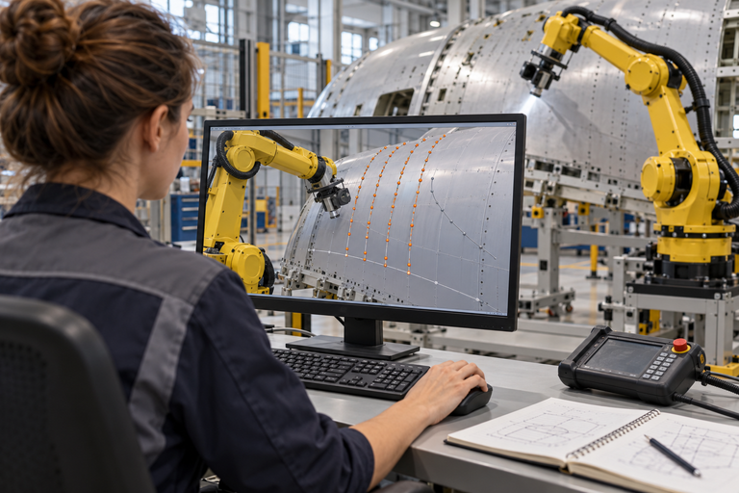

Why autonomous motion matters
A new panel
Back to programming
With autonomous motion
Different shape or position
Adjust paths. Run trials. Repeat.
Plan and adapt to the surface
Repeat for every new panel
WHAT AUTONOMY CHANGES
Automatic motion planning
Adaptive execution
Task autonomy
Less programming
Fewer corrections
Less intervention
Target: lower preparation cost and more engineering capacity
Notes:
Suggested narration (about 50 seconds):
Imagine the next aircraft panel arrives for inspection. The inspection requirement is familiar, but its curvature or its position is different. In a workflow based on taught or offline paths, that change can send an engineer back to the program to adjust the motion and try it again on the cell. This is the repeated effort I want to reduce. Automatic motion planning prepares a route for the new geometry, checking reach and configured constraints. Adaptive execution adjusts that motion using measured changes. Task autonomy then completes the agreed inspection, with people handling exceptions. The return loop represents recurring preparation when a new panel geometry requires different robot motion. The intended value is less preparation and correction effort, more engineering capacity for process quality, and a system that can handle supported panel variants more readily.
Bridge from slide 12: The pyramid showed increasing autonomy. This slide explains why capabilities 3, 4 and 5 matter when a real panel changes.
Bridge to the next two vision slides: First, explain how the motion capability could become a common framework across applications. Then explain how it could work with perception, software and simulation in a common robotics platform towards Physical AI. These vision topics intentionally remain outside this slide.
Value framing: Benefits are expected, not measured Airbus savings. Compare the current and proposed workflows on matched panels and equivalent quality criteria. Measure engineering hours for motion preparation, correction hours, cell trial hours and interventions per completed job. Report net cost savings only after including integration, sensing, compute, commissioning, validation and maintenance costs. Do not assume that less programming means zero setup or zero validation.
Capability boundaries: Automatic planning uses a configured robot, tool, task, geometry and constraints. Adaptive execution requires suitable sensing and control. Task autonomy remains within a defined operating envelope and escalates exceptions. This slide does not claim operation on every panel or surface. Offline programming remains useful for stable, repeatable processes. Constraint checking does not replace physical validation or cell safety engineering.
Technical grounding: https://moveit.picknik.ai/main/doc/concepts/motion_planning.html (motion generation, constraints, collision checking and planning pipeline), reviewed 20 October 2026. These are general capability examples, not a claim that a particular software product is deployed at Airbus.
Visual disclosure: Images are AI-generated conceptual illustrations, not actual Airbus project photographs. They illustrate a new panel arriving, manual motion reprogramming and autonomous inspection. The reprogramming image is illustrative rather than a specific software interface. Built-in image_gen prompts: undefined

Slide 14
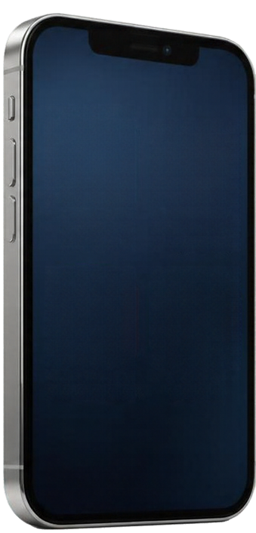


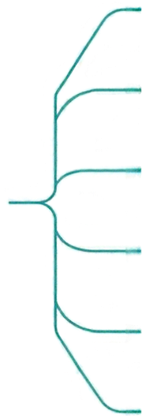
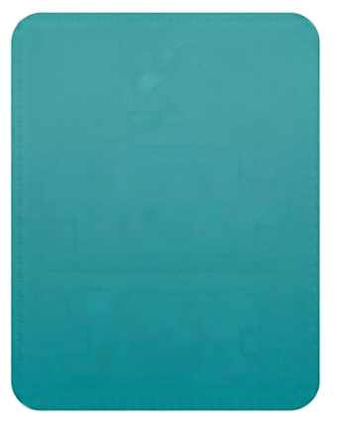






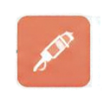




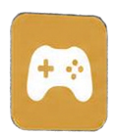





My vision: one foundation, many applications
Shared capabilities. Task-specific choices.
Inspection
Auto Rigging
Common
Motion Planning
Framework
Sealant
Photos
Payments
Pick & Place
Select toolpath,
planner and
constraints per task
Sanding
Video Calls
Games
Polishing
Reuse proven
work
Integrate
faster
Share
improvements

Slide 15
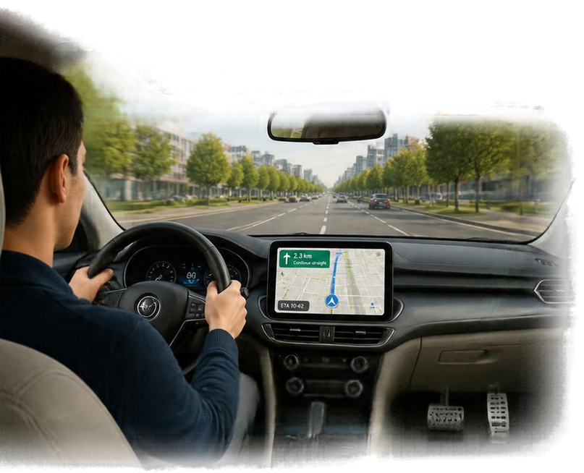
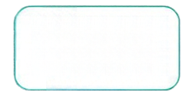
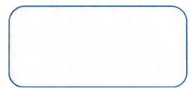



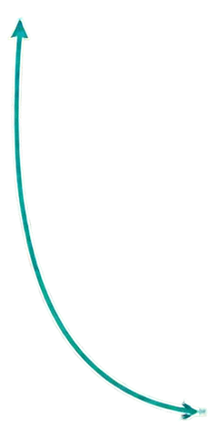
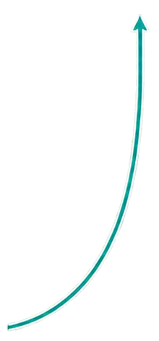
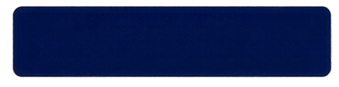

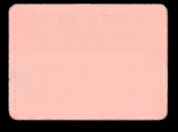



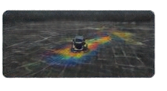
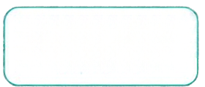




My vision: a complete robotics product
A navigation app alone cannot drive a car
See road
Perception
Navigation
Planning
Steer & brake
Control
See the panel
Vision
Plan the movement
Motion planning
Execute the task
Control
Task orchestrator: coordinates the whole task
Software stack: connects components & shares data
Monitor → coordinate → execute → adjust
Shared core • task-specific configuration
Inspection
Sealant
Simulation
Observe & adjust
Feedback
Design
Test
Deploy
Support &
improve
Together, these capabilities contribute a foundation for Physical AI

Slide 16
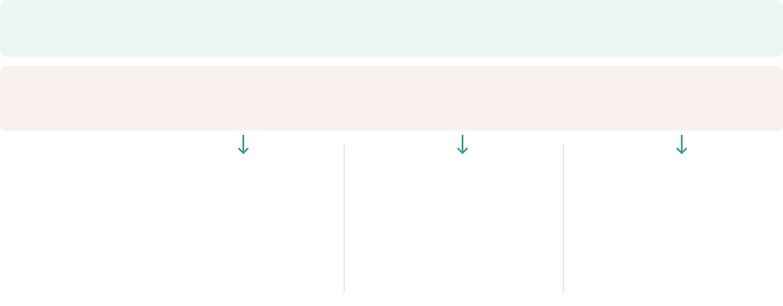
Vision & challenges
From application-specific effort to reusable, adaptive robotics
Business
challenges
New panels,
repeated programming
One-off solutions,
repeated integration
Complex tasks,
manual intervention
Technical
challenges
Different surfaces,
obstacles & motion limits
Reliable integration,
testing & lifecycle support
Limited task data &
reliable AI decisions
The direction
One motion foundation
Task-specific choices
One robotics platform
Reuse across its lifecycle
Physical AI where useful
Adaptive task decisions
Less preparation effort • reusable engineering • more adaptable manufacturing

